Slide 1
The Test
By Phil Aponte

Slide 2
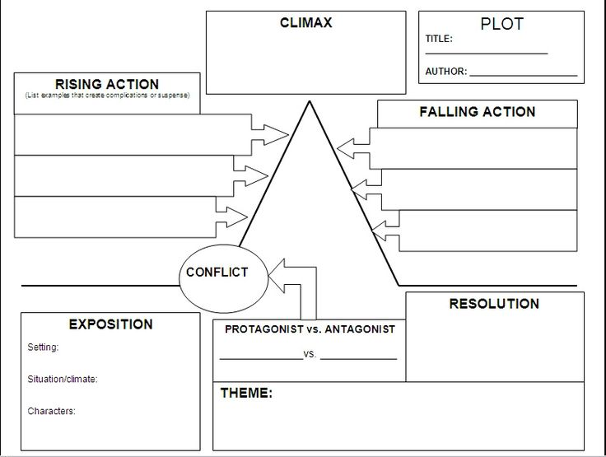
Complete the Plot Diagram

Slide 3
Questions (Answer in complete sentences)
Why did Phil hate moving?
When and where was Phil supposed to meet Ron?
When Phil is sitting in Vito’s with Ron and his friends, he feels uncomfortable. Why DO YOU THINK he stays with them?
Even though Phil passes the test, he knows he is not part of Ron’s group. Why do you think that is?
At the end of the story, Phil says that the West Side is all right for him. Why do you think he says this?
What lesson did Phil learn? How can you connect this lesson to your own life?

